Slide 1

Introduction to Software Engineering
Definitions · Lifecycle · Methodologies · Testing
Building Quality Software — The Professional Way

Slide 2
What is Software Engineering?
1
Software Engineering (SWE) is a systematic, disciplined approach to developing software
It applies engineering principles: planning, design, construction, testing & maintenance
Goal: build reliable, efficient, and maintainable software that solves real problems
SWE is not just coding — it covers the entire journey from idea to product
Core focus: quality, scalability, teamwork, and continuous improvement
Software Engineering Introduction

Slide 3
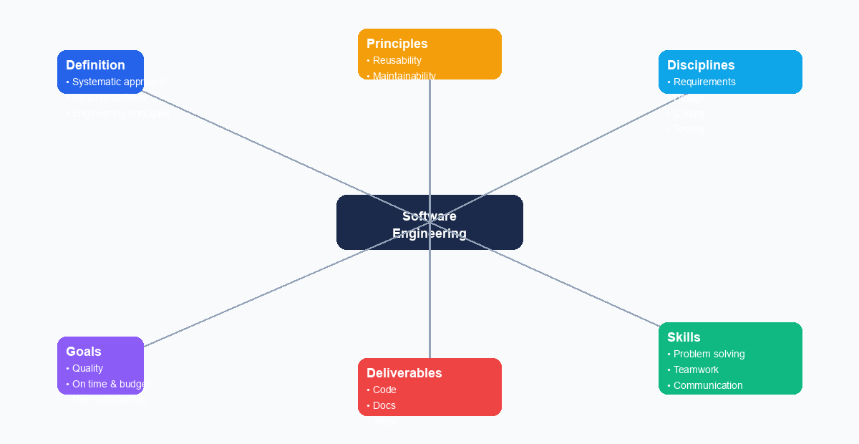
Software Engineering — Mind Map
2
Software Engineering Introduction

Slide 4
Software Development Lifecycle (SDLC)
3
SDLC is the structured process every software project follows from start to finish
7 Key Phases: Planning → Analysis → Design → Implementation → Testing → Deployment → Maintenance
Each phase has clear deliverables, reviews, and quality checkpoints
Following SDLC reduces risk, improves quality, and keeps projects on track
Software Engineering Introduction

Slide 5
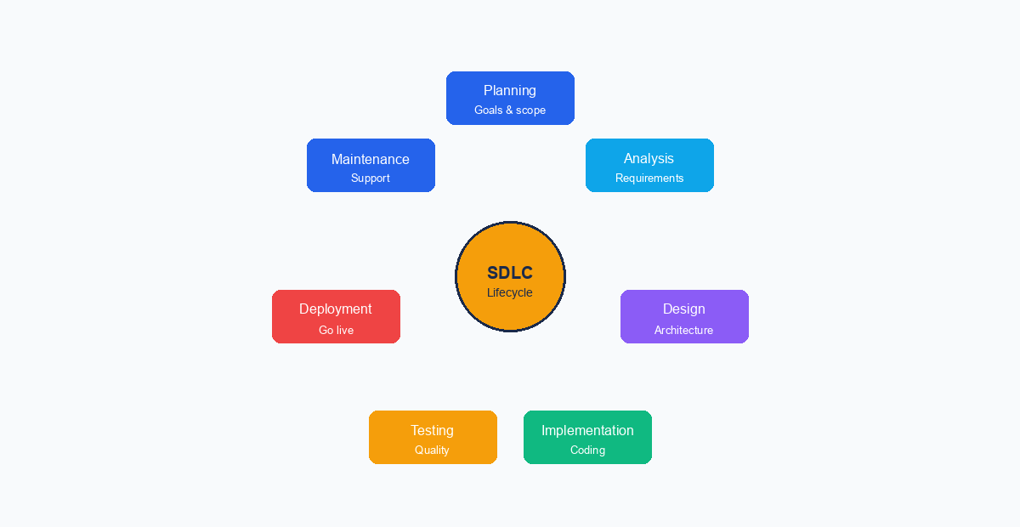
SDLC Lifecycle Diagram
4
Software Engineering Introduction

Slide 6
What Each SDLC Phase Contains
5
1. Planning
Define goals, scope, timeline, budget, and stakeholders
2. Analysis
Gather and document functional & non-functional requirements
3. Design
Architecture, UI/UX mockups, database schema, API design
4. Implementation
Write code, conduct reviews, use version control (Git)
5. Testing
Unit, integration, system, and acceptance testing
6. Deployment
Release to production via CI/CD pipelines and monitoring
7. Maintenance
Bug fixes, updates, performance tuning, and user support
Software Engineering Introduction

Slide 7
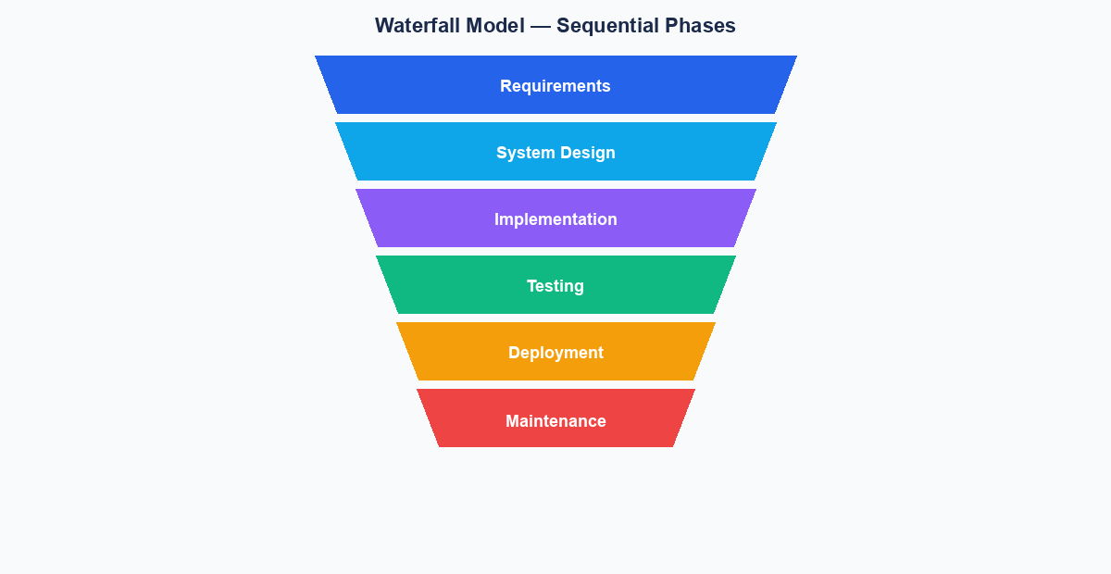
Waterfall Methodology
6
Traditional linear approach — each phase completes before the next begins
Requirements are defined upfront; changes are costly later in the cycle
Best suited for projects with clear, stable requirements
Advantages: simple structure, thorough documentation, predictable timelines
Limitations: inflexible, late feedback, risks found late in development
Software Engineering Introduction

Slide 8
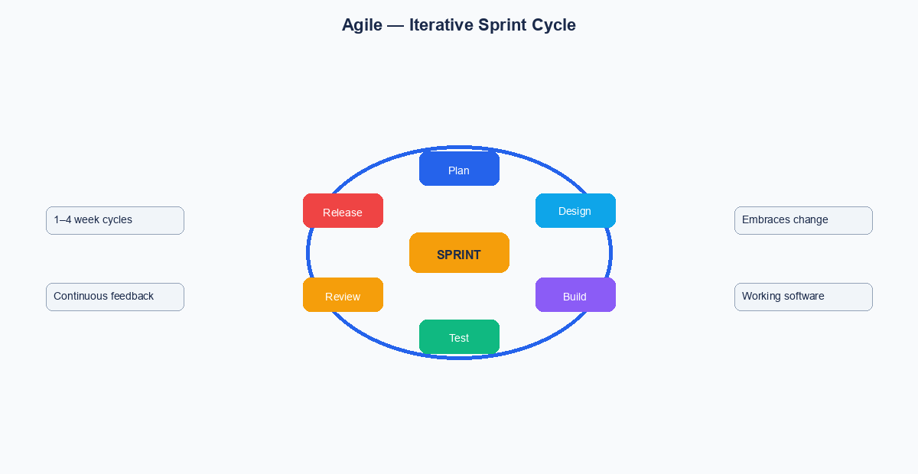
Agile Methodology
7
Iterative and incremental — work in short Sprints (1–4 weeks)
Embraces change and adapts based on customer feedback
Core values: people, working software, collaboration, responding to change
Popular frameworks: Scrum, Kanban, XP, and SAFe
Ideal for startups and products in fast-moving markets
Software Engineering Introduction

Slide 9
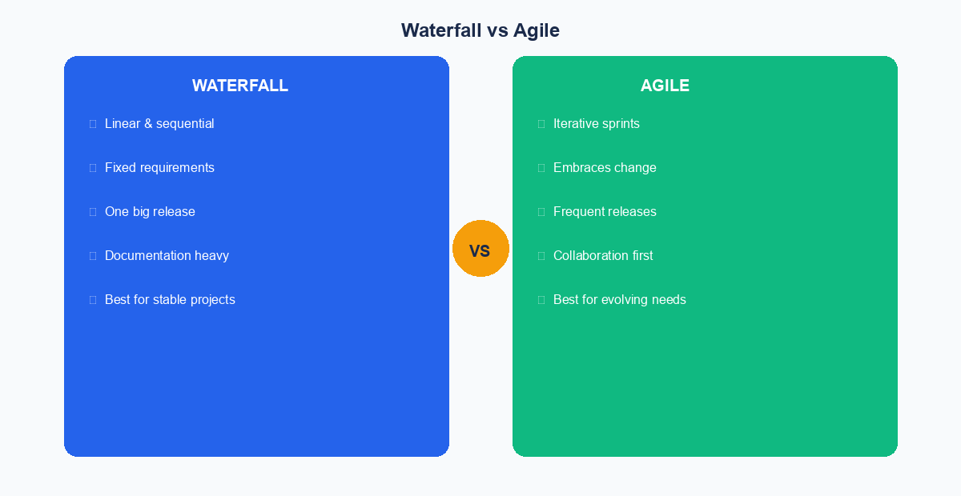
Waterfall vs Agile
8
Software Engineering Introduction

Slide 10
Software Testing — Why It Matters
9
Testing ensures software works correctly, securely, and meets user expectations
Finding bugs early saves time, money, and protects your reputation
Testing happens at every stage of the SDLC — not just at the end
Strong testing leads to confident releases and satisfied users
Testing is a shared responsibility across developers, QA, and stakeholders
Software Engineering Introduction

Slide 11
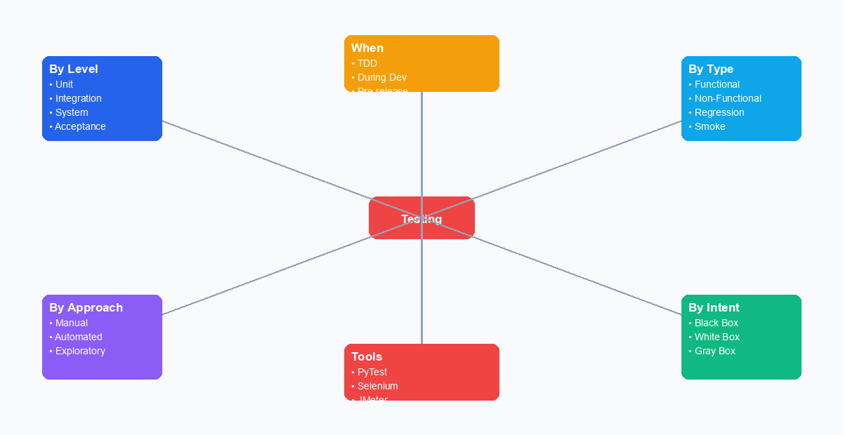
Testing Types — Mind Map
10
Software Engineering Introduction

Slide 12
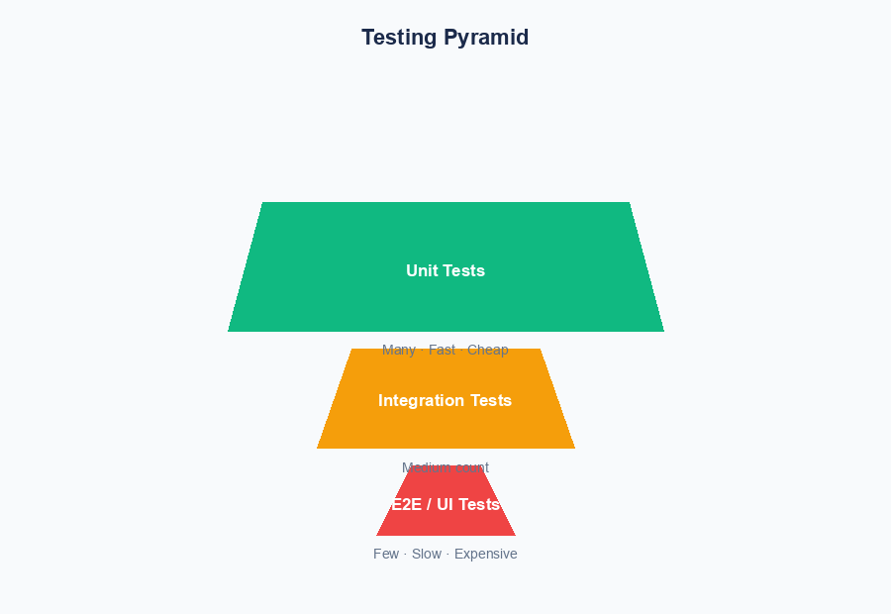
The Testing Pyramid
11
Unit Tests (base): test individual functions — fast, numerous, developer-written
Integration Tests (middle): verify modules work together correctly
E2E / UI Tests (top): test complete user flows — fewer but critical
Best practice: invest heavily in unit tests, moderate in integration, selective in E2E
Software Engineering Introduction

Slide 13
Testing Process Steps
12
1
Plan
Define scope & strategy
2
Design
Write test cases
3
Setup
Prepare environment
4
Execute
Run tests & log
5
Report
Document findings
6
Retest
Verify fixes
Software Engineering Introduction

Slide 14
Key Takeaways
13
Software Engineering is a systematic approach to building quality software
SDLC guides projects through 7 phases from planning to maintenance
Waterfall suits stable projects; Agile suits evolving, fast-paced work
Testing is essential at every level — unit, integration, system, and acceptance
Choose the methodology that best fits your project and team
Keep learning and collaborating — great software is built together
Software Engineering Introduction

Slide 15
Thank You
Questions & Discussion

